Slide 1


Ari Kurniawan
www.arikurniawan.com

Slide 2
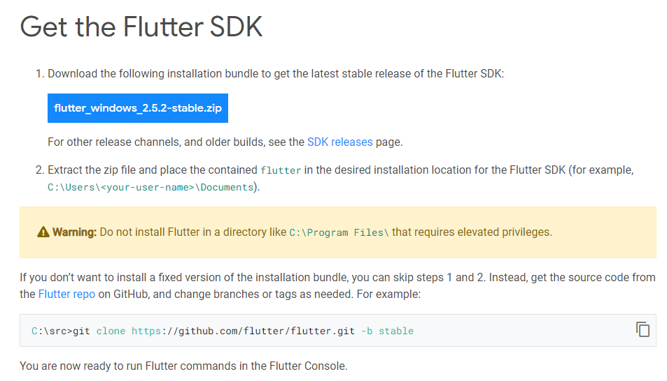
Instalasi
https://flutter.dev/docs/get-started/install/windows

Slide 3
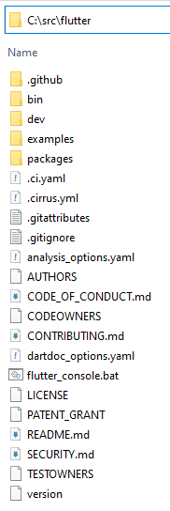
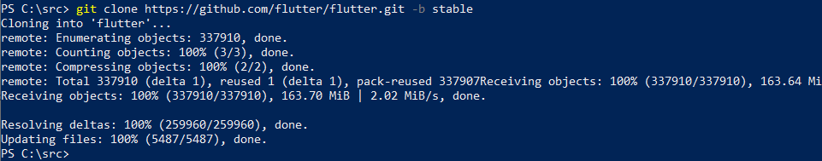
Instalasi via Git

Slide 4
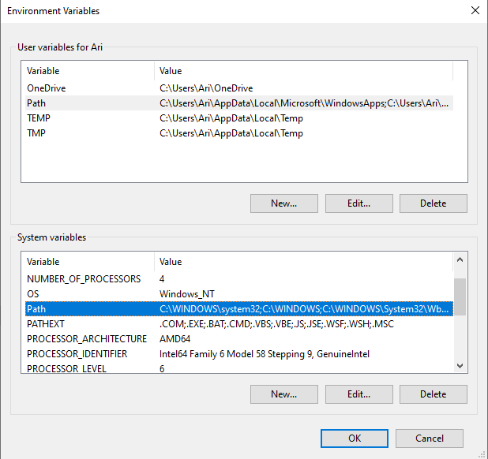
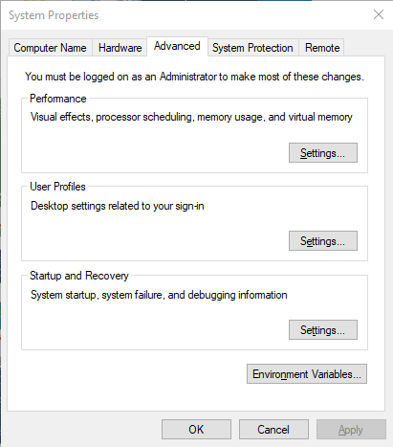
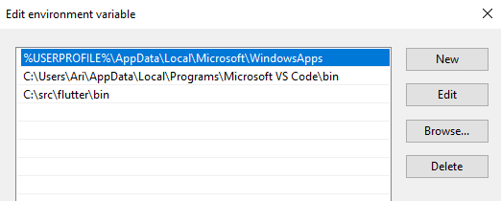
Environment Setting

Slide 5
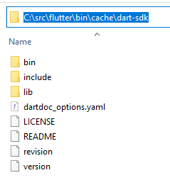
Tes Hasil Instalasi
C:\Users\Ari>flutter
Checking Dart SDK version...
Downloading Dart SDK from Flutter engine ...
Expanding downloaded archive...
Building flutter tool...
Running pub upgrade...
Manage your Flutter app development.
C:\Users\Ari>dart --version
Dart SDK version: 2.14.3 (stable) (Wed Sep 29 13:10:26 2021 +0200) on "windows_x64"

Slide 6
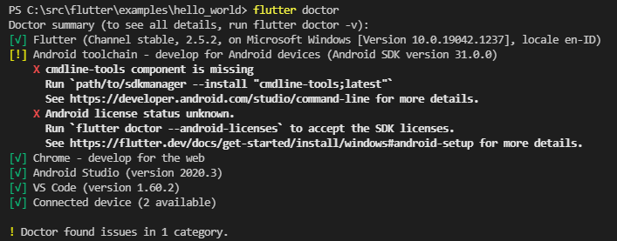
Flutter

Slide 7
PS C:\src\flutter\examples\hello_world> flutter run
Downloading Web SDK... 11.7s
Multiple devices found:
Chrome (web) • chrome • web-javascript • Google Chrome 94.0.4606.61
Edge (web) • edge • web-javascript • Microsoft Edge 94.0.992.38
[1]: Chrome (chrome)
[2]: Edge (edge)
Please choose one (To quit, press "q/Q"):

Slide 8
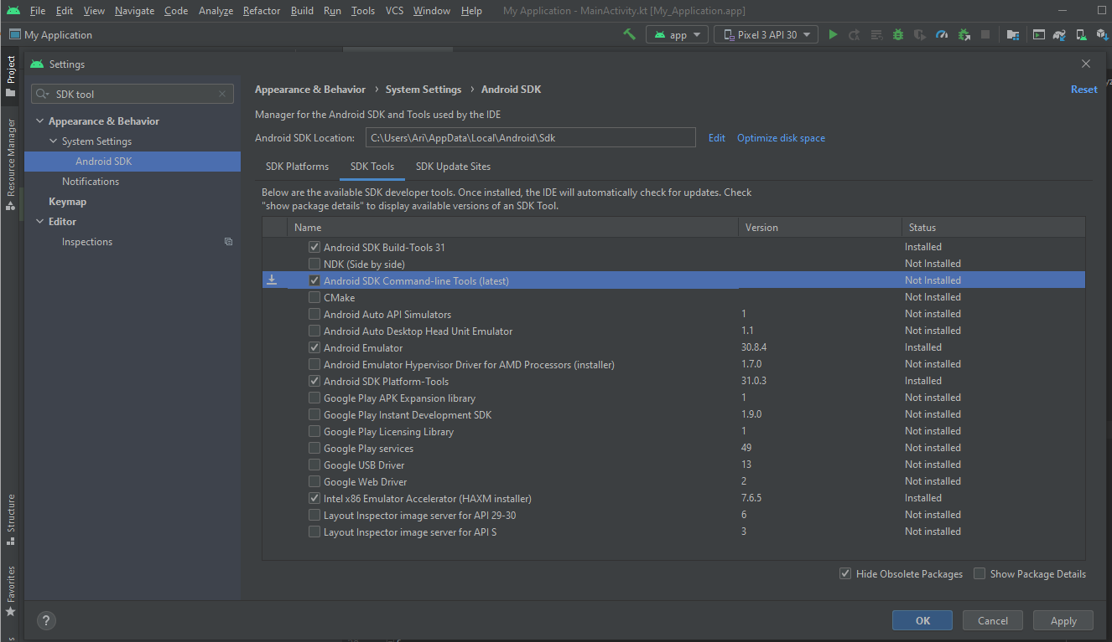
AVD – Android Virtual Device

Slide 9
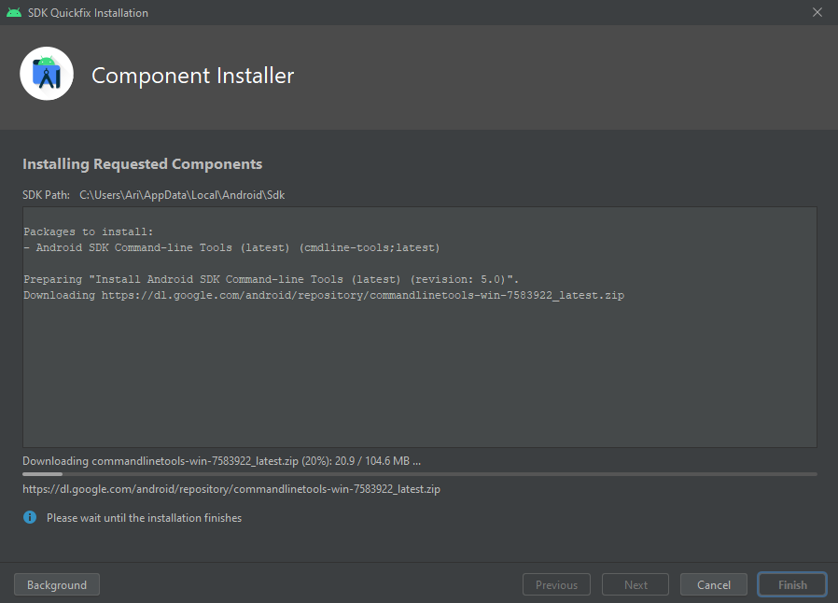

Slide 10
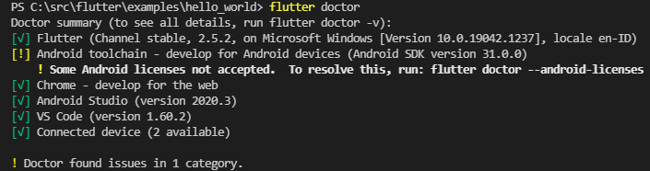
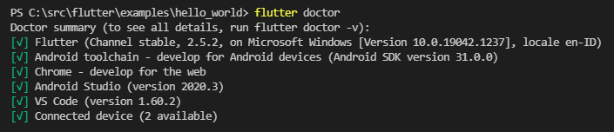

Slide 11
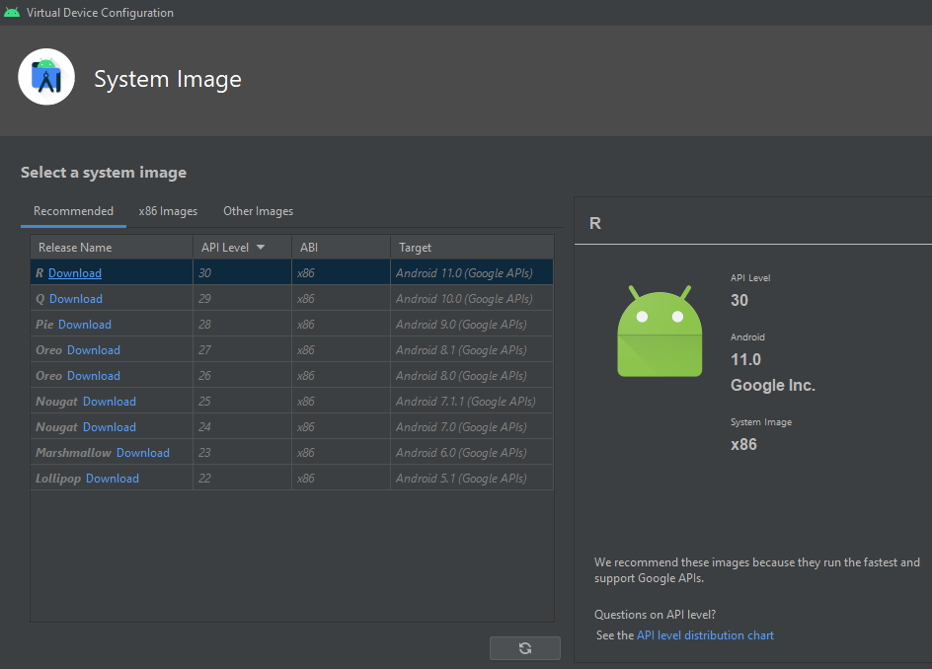
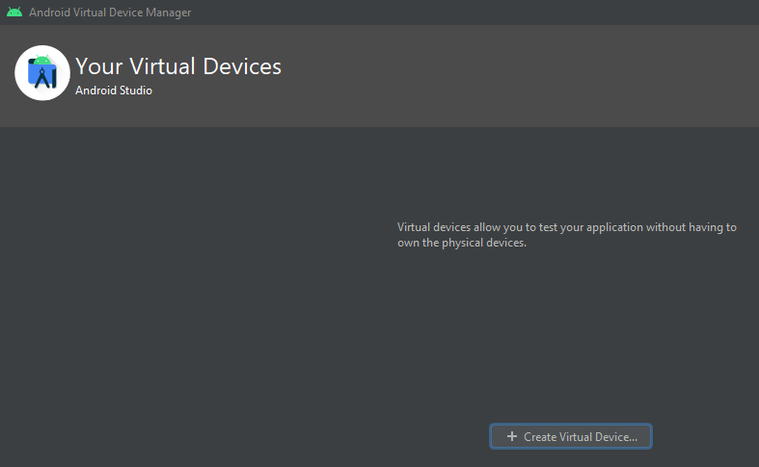
AVD – Android Virtual Device
Membuat emulator :
Android Studio
Android SDK Command-line tool

Slide 12
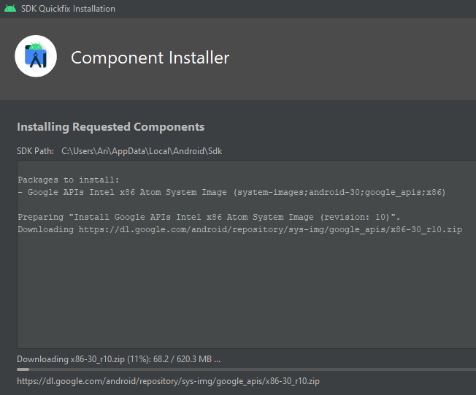

Slide 13
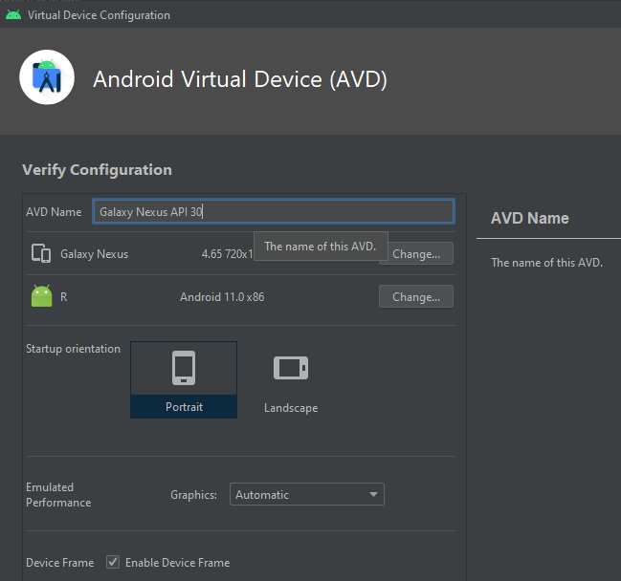

Slide 14
PS C:\src\flutter\examples\hello_world> flutter emulators
2 available emulators:
Galaxy_Nexus_API_30 • Galaxy Nexus API 30 • Google • android
Pixel_3_API_30 • Pixel 3 API 30 • Google • android
To run an emulator, run 'flutter emulators --launch <emulator id>'.
To create a new emulator, run 'flutter emulators --create [--name xyz]'.
You can find more information on managing emulators at the links below:
https://developer.android.com/studio/run/managing-avds
https://developer.android.com/studio/command-line/avdmanager
PS C:\src\flutter\examples\hello_world> flutter emulators --create --name soboteika
Emulator 'soboteika' created successfully.
PS C:\src\flutter\examples\hello_world> flutter emulators
3 available emulators:
Galaxy_Nexus_API_30 • Galaxy Nexus API 30 • Google • android
Pixel_3_API_30 • Pixel 3 API 30 • Google • android
soboteika • soboteika • Google • android
To run an emulator, run 'flutter emulators --launch <emulator id>'.
To create a new emulator, run 'flutter emulators --create [--name xyz]'.
You can find more information on managing emulators at the links below:
https://developer.android.com/studio/run/managing-avds
https://developer.android.com/studio/command-line/avdmanager

